Slide 1


Data Processing/Analysis/Science with R
Al.I. Cuza University of Iași
Faculty of Economics and Business Administration
Department of Accounting, Information Systems and Statistics
Introduction to Machine Learning
By Marin Fotache

Slide 2
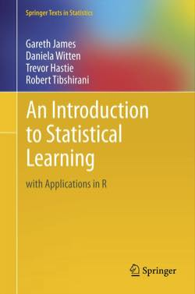
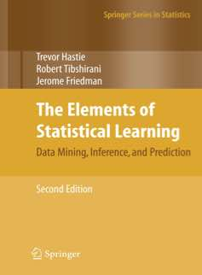
Main References (Free Books)
Gareth James, Daniela Witten, Trevor Hastie and Robert Tibshirani - An Introduction to Statistical Learning with Applications in R, Springer, 2013-2017, freely available at:
http://www-bcf.usc.edu/~gareth/ISL/index.html or http://web.stanford.edu/~hastie/pub.htm
Fundamentals of Data Science
Theoretical but with R examples
Excellent for beginers who seek to understand Data Science ingredients
Not easy
Trevor Hastie, Robert Tibshirani and Jerome Friedman - The Elements of Statistical Learning. Data Mining, Inference, and Prediction, Springer, 2009-2017, freely available at:
http://web.stanford.edu/~hastie/pub.htm
Even deeper fundamentals of Data Science
Theoretical but with R examples
Mathematical
Quite difficult for non-statisticians

Slide 3
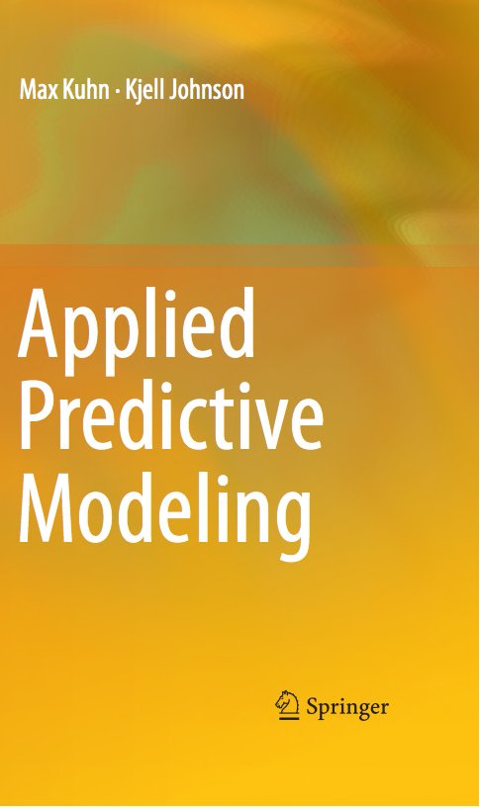
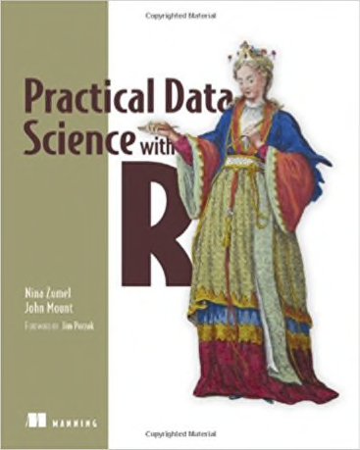
Two Other Excellent Books
Max Kuhn, Kjell Johnson - Applied Predictive
Modeling, Springer, 2013 – data and figures
available at:
Provide good explanations anout ML theory
Excellent examples
Plenty of R code
Nina Zumel, John Mount - Practical Data Science with R, Manning, 2014, available at:
https://www.amazon.com/Practical-Data-Science-Nina-Zumel/dp/1617291560 or
https://www.manning.com/books/practical-data-science-with-r
R Code and Data sets available at:
https://github.com/WinVector/zmPDSwR
Applied and well explained
Not (so much) theory
Lots of examples

Slide 4
Introductory Video/Web Courses
Statistical Learning for Data Science (Ankit Rathi)
https://towardsdatascience.com/statistical-learning-for-data-science-b61b263c1196
A Friendly Introduction to Machine Learning
https://www.youtube.com/watch?v=IpGxLWOIZy4
Introduction to Data Analysis using Machine Learning
https://www.youtube.com/watch?v=U4IYsLgNgoY
Architecting Predictive Algorithms for Machine Learning
https://www.youtube.com/watch?v=KoQdAdxjnoU&t=3521s
Introduction to Statistical Learning (Hastie and Tibshirani)
https://www.youtube.com/watch?v=2wLfFB_6SKI&list=PL5-da3qGB5ICcUhueCyu25slvsGp8IDTa
https://lagunita.stanford.edu/c4x/HumanitiesScience/StatLearning/asset/introduction.pdf
https://www.youtube.com/watch?v=LvaTokhYnDw&list=PL5-da3qGB5ICcUhueCyu25slvsGp8IDTa

Slide 5
(More) Advanced Video/Web Courses
Trevor Hastie and Robert Tibshirani - In-depth introduction to machine learning (15 hours of videos)
https://www.r-bloggers.com/in-depth-introduction-to-machine-learning-in-15-hours-of-expert-videos/
Based on book: Gareth James, Daniela Witten, Trevor Hastie and Robert Tibshirani - An Introduction to Statistical Learning with Applications in R, Springer, 2013
PDF slides
Video lessons
Very good (not easy, though ☺)
Abbass Al Sharif - DSO 530: Applied Modern Statistical Learning Techniques
https://www.alsharif.info/iom530
PDF documentation, PPT slides
R code
Projects
Some video-lessons

Slide 6
Agenda
Basic vocabulary for Machine Learning (ML)
Scoring (regression) vs Classification
Supervised vs. Unsupervised Learning
Bias vs Variance in ML modeling
Main ML Techniques; performance evaluation of ML models
Introduction to resampling: train-test split, cross-validation, bootstrapping
Four main types of dealing with ML Models in R
With specific base functions/packages (e.g. `lm()`, `rpart::rpart()`, `ipred::bagging()`, etc.)
require many steps for data preparation, model fitting, evaluations etc.
require some other packages for data preparation and model assessment
With the `caret` package
`one-package-fits-all` modeling: `caret` integrates many techniques/algorithms, including data preparation and model assessment
somehow `over-weighted`; does not integrate smoothly with the `tidyverse`
Using (mainly) the `modelr` package
One of the first attempts to apply the `tidyverse` approach to modeling
Support for just a limited range of ML techniques
With `tidymodels` ecosystem (rsample, recipes, parnsnip, yardstick etc)
Loose package of packages for integrating all ML techniques within common framework, such `tidyverse` is for data processing
Very dynamic and still poorly documented (at least for now – December 2018)

Slide 7
Agenda (cont.)
Cross-validating a single Ordinary Least Squares(OLS) model
with `caret` package
with `modelr` package
with `tidymodels` ecosystem
Cross-validating multiple OLS models
with `caret` package
with `modelr` package
with `tidymodels` ecosystem
Cross-validating a single Logistic Regression model
with `caret` package
with `modelr` package
with `tidymodels` ecosystem

Slide 8
Scripts on GitHub
See section 13 Introduction to Machine Learning of the course:
https://github.com/marinfotache/Data-Processing-Analysis-Science-with-R/tree/master/13%20Introduction%20to%20Machine%20Learning
Scripts related to this presentation:
13a KV of a scoring model with caret, modelr and tidymodels.R
13b KV of multiple scoring models with caret, modelr and tidymodels.R
13c KV of classsification models with caret, modelr and tidymodels.R

Slide 9
Common Data Science/Machine Learning Techniques (Zumel and Mount, 2014)
Classification - Deciding if something belongs to one category or another
Scoring - Predicting or estimating a numeric value, such as a price or probability
Ranking - Learning to order items by preferences
Clustering - Grouping items into most-similar groups
Finding relations - Finding correlations or potential causes of effects seen in the data
Characterization - Very general plotting and report generation from data

Slide 10
Basic Scoring Methods
Method | Description
Linear regression | Builds a model such that the predicted numerical output is a linear additive function of the inputs. Effective approximation even when the underlying situation is in fact nonlinear. Resulting model gives an indication of the relative impact of each input variable on the output. Easy to comprehend
Logistic regression | Predicts a value between 0 and 1 Suitable for predicting probabilities (when the observed outcome is a categorical value) and rates (when the observed outcome is a rate or ratio). Mostly used in classification problems (assigning an observation to a class of objects) –see next slide

Slide 11
Classification Methods
Method | Description
Naive Bayes | Appropriate for problems with many input variables, categorical input variables with a very large number of possible values, and text classification
Decision trees | Applied for both scoring and classification problems Models are easy to interpret Deals better than other methods with correlated predictors and with missing values
Logistic regression | Appropriate when estimating the probability that an object is in a given class., e.g. estimating the probability of default for a loan customer. Assess the relative impact of different input variables on the output
Support vector machines | Appropriate when there are many input variables, when input variables interact with the outcome or with each other in complicated (nonlinear) ways. Fewer assumptions about variable distribution Suitable when the main goal is prediction, and less generous when the interest is in explaining how/why the model behaves

Slide 12
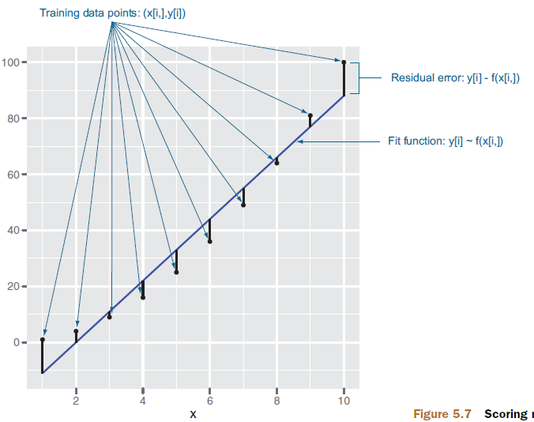
Evaluating Scoring Models
The main concept: residuals - the difference between our predictions f(x[i,]) and actual outcomes y[i]

Slide 13
Evaluating Scoring Models (cont.)
Measure | Description
Root Mean Square Error | Measure of the difference between model prediction and the actual values. Similar to a standard deviation: how much the prediction is typically off. RMSE is in the same units as y-values are
R-squared | Coefficient of determination) = 1.0 minus how much unexplained variance your model leaves. R-squared is dimensionless (it’s not the units of what you’re trying to predict) Best possible R-squared is 1.0 (with near-zero or negative R-squared being horrible). R-squared can be explained of as the fraction of the outcome (y variable) variation that is explained by the model.

Slide 14
Evaluating Classification Models
A classification model places examples into two or more categories
Tool: confusion matrix
 | Event | Non-Event
Event | True Positives (TP) | False Positives (FP)
Non-Event | False Negatives (FP) | True Negatives (TN)
Observed
Predicted

Slide 15
Classifier Performance Measures
Measure | Formula
Accuracy - what fraction of the time the classifier is correct
Precision - a measure of confirmation (when the classifier indicates positive, how often it is in fact correct)
Recall - a measure of utility (how much the classifier finds of what there actually is to find)
Sensitivity (the true positive rate) – what fraction of class members are identified as positive and what fraction of non-class members are identified as negative
Specificity (the true negative rate) – what fraction of class members are identified as positive and what fraction of non-class members are identified as negative

Slide 16
Some References on model performance evaluation and cross-validation
What is the meaning of "root mean squared error" (RMSE) in statistics?
https://www.quora.com/What-is-the-meaning-of-root-mean-squared-error-RMSE-in-statistics
Machine Learning Fundamentals: The Confusion Matrix
https://www.youtube.com/watch?v=Kdsp6soqA7o
Machine Learning Fundamentals: Cross Validation
https://www.youtube.com/watch?v=fSytzGwwBVw
StatsLearning Lect7b 110613
https://www.youtube.com/watch?v=nZAM5OXrktY

Slide 17
Resources on the `caret` package (including cross-validation for linear and logistic regression)
Cross-validation Tutorial
https://quantdev.ssri.psu.edu/tutorials/cross-validation-tutorial
Predictive modeling and machine learning in R with the caret package
https://www.zevross.com/blog/2017/09/19/predictive-modeling-and-machine-learning-in-r-with-the-caret-package/
Igor Hut - Exploring the caret package
http://rstudio-pubs-static.s3.amazonaws.com/251240_12a8ecea8e144fada41120ddcf52b116.html
Caret Package – A Practical Guide to Machine Learning in R
https://www.machinelearningplus.com/machine-learning/caret-package/
Out of sample predictions from OLS regressions: a K-folds tutorial in R
https://janzilinsky.com/cross-validation-ols-k-folds-out-of-sample-predictions-in-r/
A comprehensive Machine Learning workflow with multiple modelling using caret and caretEnsemble in R
https://towardsdatascience.com/a-comprehensive-machine-learning-workflow-with-multiple-modelling-using-caret-and-caretensemble-in-fcbf6d80b5f2

Slide 18
Resources on `modelr`
David Robinson - Cross validation of linear regression with modelr
http://rpubs.com/dgrtwo/cv-modelr
k-fold cross validation with modelr and broom
https://drsimonj.svbtle.com/k-fold-cross-validation-with-modelr-and-broom
Stephanie J. Spielman - K-fold cross validation in the Tidyverse
http://sjspielman.org/bio5312_fall2017/files/kfold_supplement.pdf
Model-selection using cross-validation
https://ijlyttle.github.io/model_cv_selection.html#
Out of sample predictions from OLS regressions: a K-folds tutorial in R
https://janzilinsky.com/cross-validation-ols-k-folds-out-of-sample-predictions-in-r/
Package ‘modelr’
https://cran.r-project.org/web/packages/modelr/modelr.pdf
Logistic Regression
http://uc-r.github.io/logistic_regression

Slide 19
Resources on `tidymodels` packages
Resources on `rsamples` package
https://tidymodels.github.io/rsample/
In an R /R Studio session, type/launch: `browseVignettes("rsample")`
Resources on `recipes` package
see vignettes at https://cran.r-project.org/web/packages/recipes/index.html
Introduction to Recipes (R Package) | RStudio Webinar - 2017
https://www.rstudio.com/resources/webinars/creating-and-preprocessing-a-design-matrix-with-recipes/ or
https://www.youtube.com/watch?v=v6pS061sUlw
Edwin Thoen - A recipe for recipes: https://edwinth.github.io/blog/recipes_blog/

Slide 20
Resources on `tidymodels` modeling (all steps)
Modeling in the Tidyverse (Max Kuhn)
https://www.rstudio.com/resources/videos/modeling-in-the-tidyverse/
A tutorial on tidy cross-validation with R
https://www.brodrigues.co/blog/2018-11-25-tidy_cv/
Tidymodeling Titanic Tragedy
https://cdn.rawgit.com/ClaytonJY/tidymodels-talk/145e6574/slides.html#1

